Slide 1
CS5560 Knowledge Discovery Management
Tutorial 3
6th Feb 2020

Slide 2
Overview
Triplet Extraction
Openie CoreNLP
WordNet
ConceptNet

Slide 3
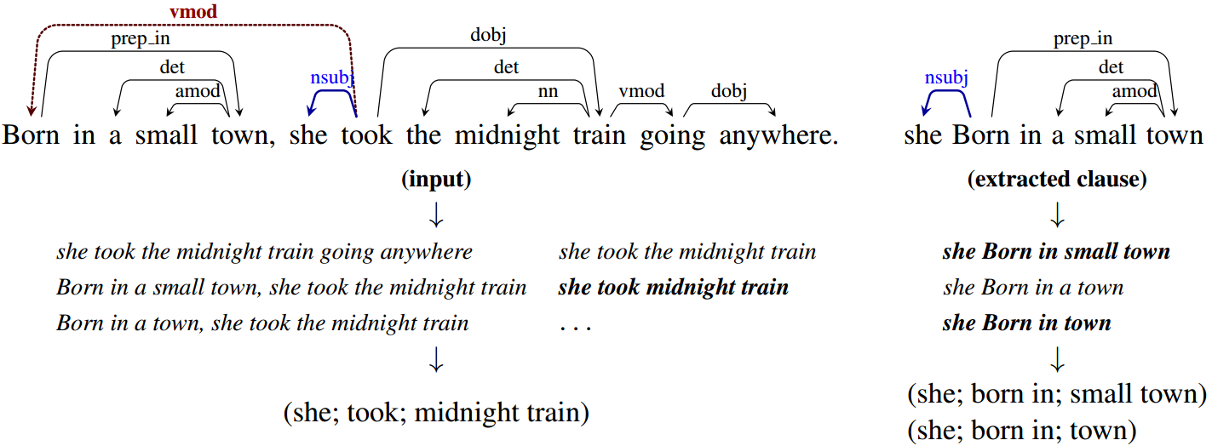
OpenIE
Sentence:
Barack Obama was born in Hawaii
Triple:
(Barack Obama; was born in; Hawaii)
corresponding to the open domain relation "was born in".
It refers to the extraction of structured relation triples from plain text.

Slide 4
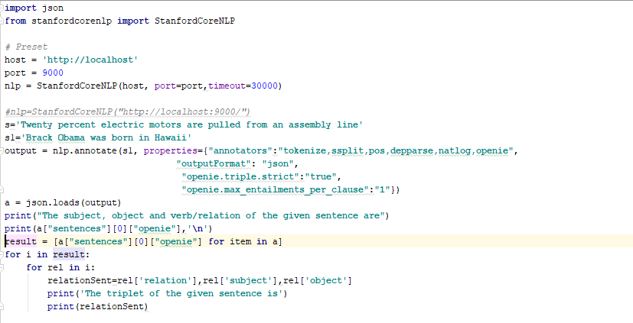
OpenIE Code

Slide 5
Command for CoreNLP on cmd
java –mx4g -cp "*" edu.stanford.nlp.pipeline.StanfordCoreNLPServer -port 9000 -timeout 15000

Slide 6
OPENIE using CoreNLP
Ref (http://nlp.stanford.edu/software/openie.html)
INPUT
Keep your kitchen and bathrooms clean.
Mold and germs can form very easily in those two rooms.
Keep food off the floor and sweep often.
Wash dirty dishes daily.
Wear rubber gloves when using cleaning products.
Some products contain chemicals.
Keep cleaning products away from children.
Many products are poisonous.
Find a high, safe place to store cleaning products.
Help keep your children’s school or a nearby park clean.
Recycle cans, bottles and paper.

Slide 7
OPENIE using CoreNLP
Ref (http://nlp.stanford.edu/software/openie.html)
OUTPUT
[(You,are in,environment,1.0), (You,are in,environment right now,1.0), (You,are in,environment now,1.0)][(You,are in,environment,1.0), (You,are in,environment right now,1.0), (You,are in,environment now,1.0)][(You,are in,environment,1.0), (You,are in,environment right now,1.0), (You,are in,environment now,1.0)]
[(It,is,are,1.0), (It,is,anywhere are,1.0)][(It,is,are,1.0), (It,is,anywhere are,1.0)]
[(products,contain,chemicals,1.0)]
[(Many products,are,poisonous,1.0), (products,are,poisonous,1.0)][(Many products,are,poisonous,1.0), (products,are,poisonous,1.0)]
[(your environment,Is,healthy,1.0)]
[(Pollution,can,can found anywhere,1.0), (Pollution,can,can found,1.0)][(Pollution,can,can found anywhere,1.0), (Pollution,can,can found,1.0)]
[(Pollution,is,bad,1.0), (Pollution,is bad for,your health,1.0)][(Pollution,is,bad,1.0), (Pollution,is bad for,your health,1.0)]
[(children,has,school,1.0)]

Slide 8
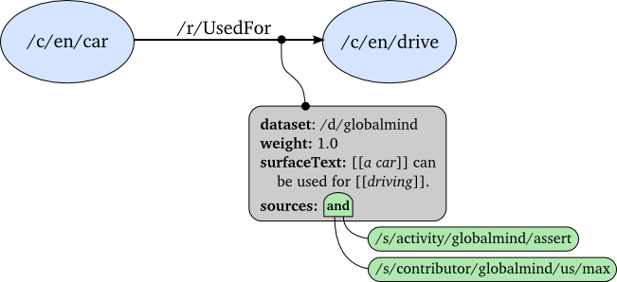
Concept Extraction using ConceptNet5
Ref: http://conceptnet5.media.mit.edu/
REST API used to retrieve the concepts or relationships.

Slide 9
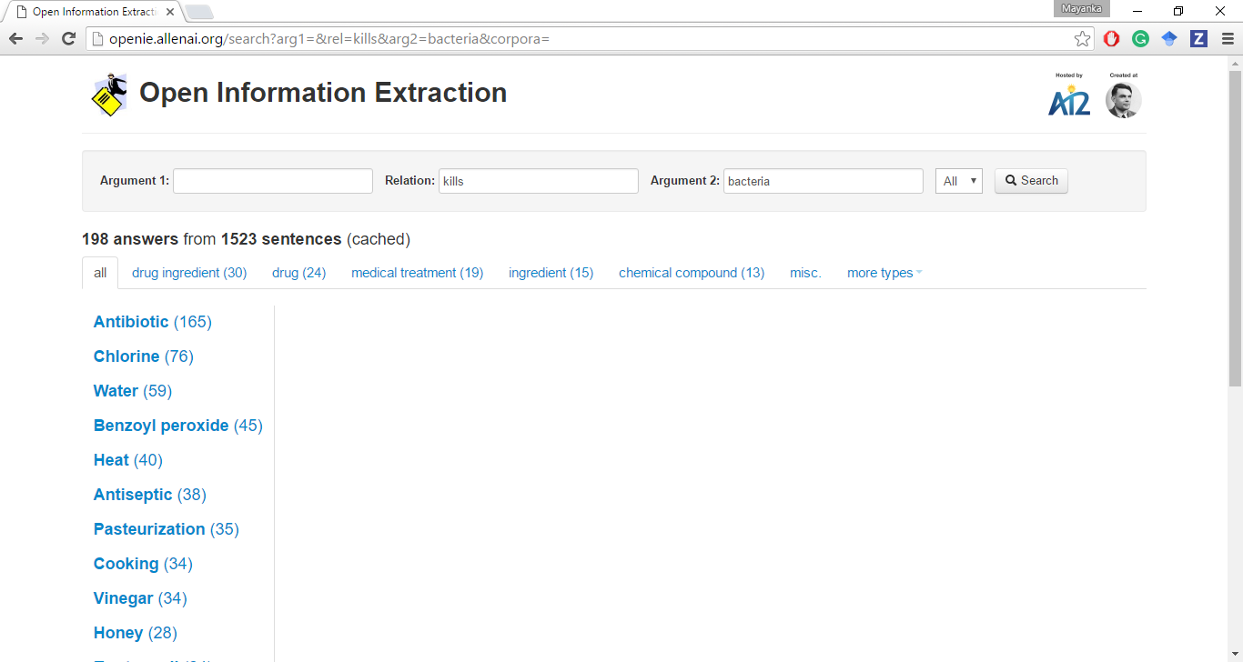
OPENIE from University of Washington
Ref (http://openie.allenai.org/)
Online service provides list of possible relations.

Slide 10
WORDNET using Python
WordNet® is a large lexical database of English. Nouns, verbs, adjectives and adverbs are grouped into sets of cognitive synonyms (synsets), each expressing a distinct concept. (https://wordnet.princeton.edu/)

Slide 11
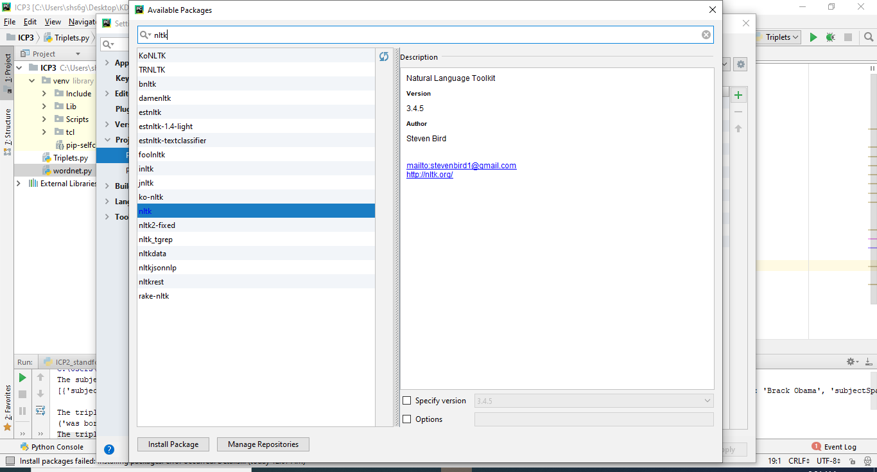
Adding NLTK Library in Pycharm

Slide 12
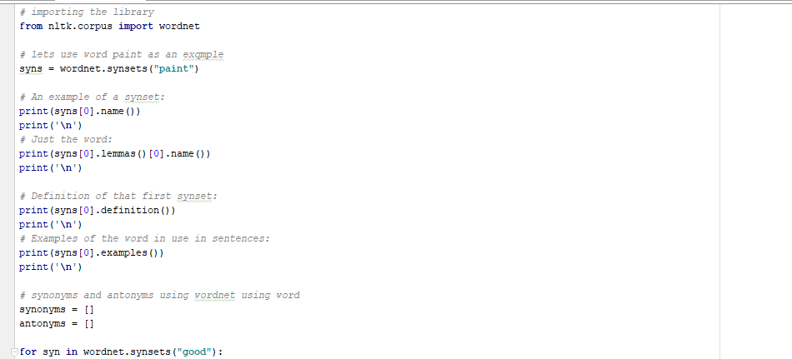
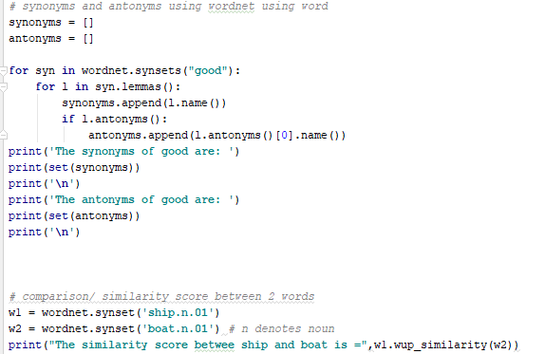
NLTK WordNet
NLTK has wordnet packages
GetPOS, GetAllSynonymns, etc. are shown in the implementation

Slide 13
WordNet Synonyms, Synsets, POS Retrival
OUTPUT
Finding parts of speech for run.
v
N
Definitions for eat:
take in solid food
eat a meal; take a meal
take in food; used of animals only
worry or cause anxiety in a persistent way
use up (resources or materials)
cause to deteriorate due to the action of water, air, or an acid
Synonyms for tired (pos: a)
all in
aweary
banal
beat
blear
blear-eyed
bleary
bleary-eyed
bored
burned-out

Slide 14
Lexical relationship WordNet
Hyponym (a more specific concept)
Hypernym (a more general concept)
Meronym (denotes a part of something)
Holonym (denotes a membership to something)
Entailment (denotes how verbs are involved)

Slide 15
ICP
Manual Triplet extraction using python library/ custom code
Performing lexical relationship with WordNet and Python

